Slide 1
Concept Learning
The problem of inducing general functions from specific training examples is central to learning.
Concept learning: acquiring the definition of a general category given a sample of positive and negative training examples of the category.
Concept learning can be formulated as a problem of searching through a predefined space of potential hypotheses for the hypothesis that best fits the training examples.
This chapter presents several learning algorithms and considers situations under which they converge to the correct hypothesis.
‹#›
Notes:
‹#›

Slide 2
Much of learning involves acquiring general concepts from specific training examples.
People, for example, continually learn general concepts or categories such as "bird," "car," "situations in which I should study more in order to pass the exam," etc.
Each such concept can be viewed as describing some subset of objects or events defined over a larger set (e.g., the subset of animals that constitute birds).
Alternatively, each concept can be thought of as a boolean-valued function defined over this larger set (e.g., a function defined over all animals, whose value is true for birds and false for other animals).
‹#›

Slide 3
In this chapter we consider the problem of automatically inferring the general definition of some concept, given examples labeled as members or nonmembers of the concept.
This task is commonly referred to as concept learning, or approximating a boolean-valued function from examples.
Concept learning. Inferring a boolean-valued function from training examples of its input and output.
consider the example task of learning the target concept "days on which my friend Aldo enjoys his favorite watersport."
Table 2.1 describes a set of example days, each represented by a set of attributes.
The attribute EnjoySport indicates whether or not Aldo enjoys his favorite water sport on this day.
‹#›

Slide 4
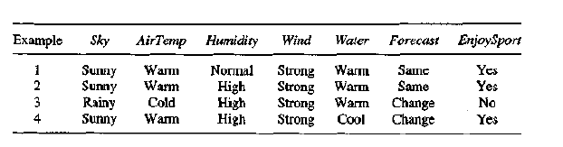
The task is to learn to predict the value of EnjoySport for an arbitrary day, based on the values of its other attributes.
Let us begin by considering a simple representation in which each hypothesis consists of a conjunction of constraints on the instance attributes.
In particular, let each hypothesis be a vector of six constraints, specifying the values of the six attributes Sky, AirTemp, Humidity, Wind, Water, and Forecast.
‹#›

Slide 5
For each attribute, the hypothesis will either
indicate by a "?' that any value is acceptable for this attribute,
specify a single required value (e.g., Warm) for the attribute, or
indicate by a "θ" that no value is acceptable.
If some instance x satisfies all the constraints of hypothesis h, then h classifies x as a positive example (h(x) = 1).
To illustrate, the hypothesis that Aldo enjoys his favorite sport only on cold days with high humidity (independent of the values of the other attributes) is represented by the expression
(?, Cold, High, ?, ?, ?)
‹#›

Slide 6
The most general hypothesis-that every day is a positive example-is represented by
(?, ?, ?, ?, ?, ?)
and the most specific possible hypothesis-that no day is a positive example-is represented by ( θ,θ,θ,θ,θ,θ)
To summarize, the EnjoySport concept learning task requires learning the set of days for which EnjoySport = yes, describing this set by a conjunction of constraints over the instance attributes.
‹#›

Slide 7
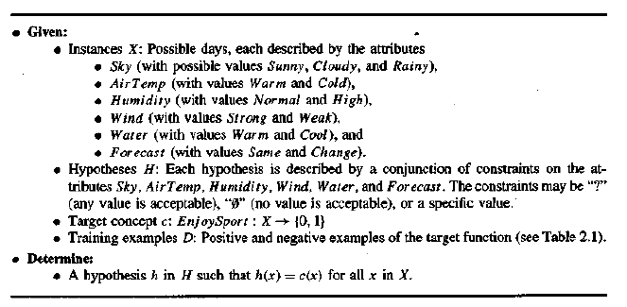
In general, any concept learning task can be described by the set of instances over which the target function is defined, the target function, the set of candidate hypotheses considered by the learner, and the set of available training examples.
The definition of the EnjoySport concept learning task in this general form is given in Table 2.2.
‹#›

Slide 8
The set of items over which the concept is defined is called the set of instances, which we denote by X.
In the current example, X is the set of all possible days, each represented by the attributes Sky, AirTemp, Humidity, Wind, Water, and Forecast.
The concept or function to be learned is called the target concept, which we denote by c. In general, c can be any Boolean valued function defined over the instances X; that is, c : X ε (1, 0).
In the current example, the target concept corresponds to the value of the attribute EnjoySport (i.e., c(x) = 1 if EnjoySport = Yes, and c(x) = 0 if EnjoySport = No).
‹#›

Slide 9
When learning the target concept, the learner is presented a set of training examples, each consisting of an instance x from X, along with its target concept value c(x) (e.g., the training examples in Table 2.1).
Instances for which c(x) = 1 are called positive examples, or members of the target concept.
Instances for which C(X) = 0 are called negative examples, or nonmembers of the target concept.
We will often write the ordered pair (x, c(x)) to describe the training example consisting of the instance x and its target concept value c(x).
We use the symbol D to denote the set of available training examples.
‹#›

Slide 10
Given a set of training examples of the target concept c, the problem faced by the learner is to hypothesize, or estimate, c.
We use the symbol H to denote the set of all possible hypotheses that the learner may consider regarding the identity of the target concept.
In general, each hypothesis h in H represents a boolean-valued function defined over X; that is, h : X ->(0, 1).
The goal of the learner is to find a hypothesis h such that h(x) = c(x) for all x in X.
The inductive learning hypothesis. Any hypothesis found to approximate the target function well over a sufficiently large set of training examples will also approximate the target function well over other unobserved examples.
‹#›

Slide 11
CONCEPT LEARNING AS SEARCH
Concept learning can be viewed as the task of searching through a large space of hypotheses implicitly defined by the hypothesis representation.
The goal of this search is to find the hypothesis that best fits the training examples.
It is important to note that by selecting a hypothesis representation, the designer of the learning algorithm implicitly defines the space of all hypotheses that the program can ever represent and therefore can ever learn.
Consider, for example, the instances X and hypotheses H in the EnjoySport learning task.
‹#›

Slide 12
Given that the attribute Sky has three possible values, and that AirTemp, Humidity, Wind, Water, and Forecast each have two possible values, the instance space X contains exactly 3 .2 . 2 .2 2 .2 = 96 distinct instances.
A similar calculation shows that there are 5.4.4.4 .4.4 = 5120 syntactically distinct hypotheses within H.
Notice, however, that every hypothesis containing one or more "θ" symbols represents the empty set of instances; that is, it classifies every instance as negative.
Therefore, the number of semantically distinct hypotheses is only 1 + (4.3.3.3.3.3) = 973
Our EnjoySport example is a very simple learning task, with a relatively small, finite hypothesis space. Most practical learning tasks involve much larger, sometimes infinite, hypothesis spaces.
‹#›

Slide 13
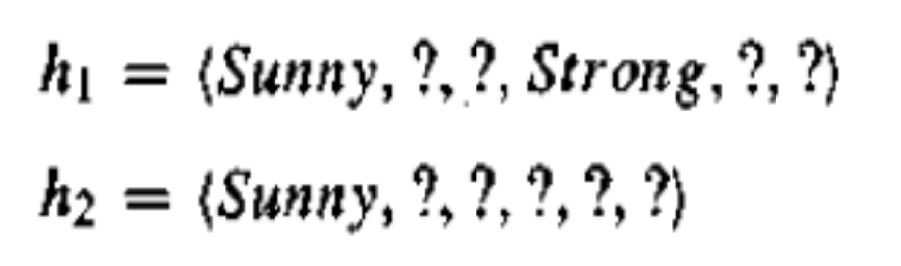
General-to-Specific Ordering of Hypotheses
Many algorithms for concept learning organize the search through the hypothesis space by relying on a very useful structure that exists for any concept learning problem: a general-to-specific ordering of hypotheses.
By taking advantage of this naturally occurring structure over the hypothesis space, we can design learning algorithms that exhaustively search even infinite hypothesis spaces without explicitly enumerating every hypothesis.
To illustrate the general-to-specific ordering, consider the two hypotheses
Now consider the sets of instances that are classified positive by hl and by h2.
‹#›

Slide 14
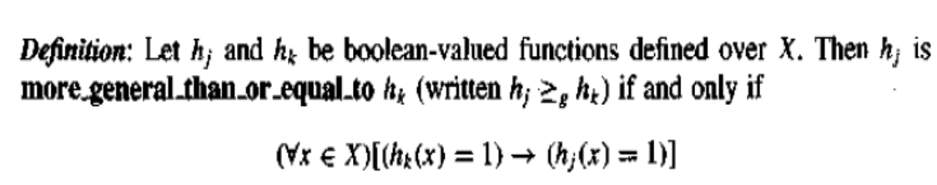
Because h2 imposes fewer constraints on the instance, it classifies more instances as positive.
In fact, any instance classified positive by hl will also be classified positive by h2. Therefore, we say that h2 is more general than hl.
we will sometimes find the inverse useful and will say that hj is more specific than hk when hk is more_general-than hj.
‹#›

Slide 15
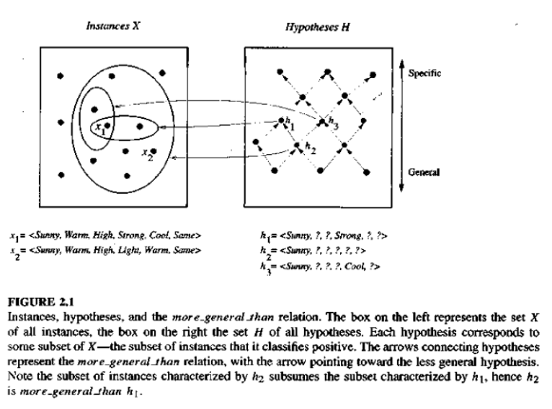
‹#›

Slide 16
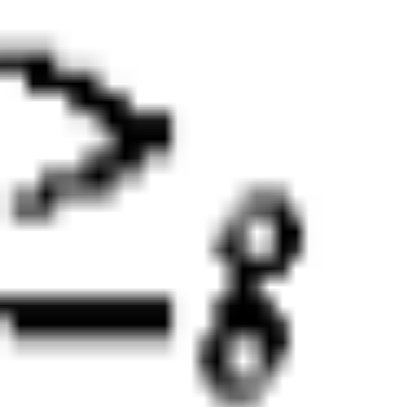
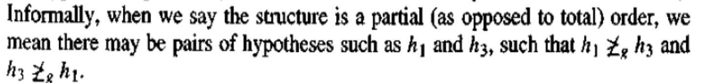
Formally, the p, relation defines a partial order over the hypothesis space H (the relation is reflexive, antisymmetric, and transitive).
The relation is important because it provides a useful structure over the hypothesis space H for any concept learning problem.
‹#›

Slide 17
FIND-S: FINDING A MAXIMALLY SPECIFIC HYPOTHESIS
How can we use the more-general-than partial ordering to organize the search for a hypothesis consistent with the observed training examples?
One way is to begin with the most specific possible hypothesis in H, then generalize this hypothesis each time it fails to cover an observed positive training example. (We say that a hypothesis "covers" a positive example if it correctly classifies the example as positive.)
To be more precise about how the partial ordering is used, consider the FIND-S algorithm defined in Table 2.3.
‹#›

Slide 18
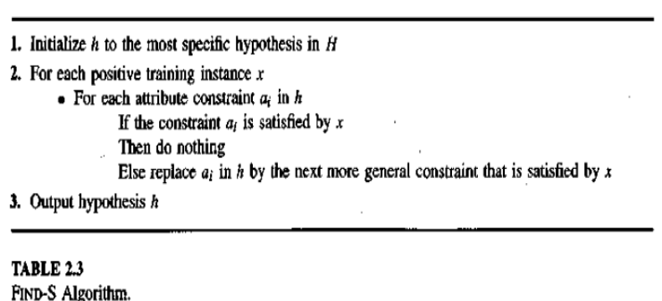
Find-S
‹#›

Slide 19
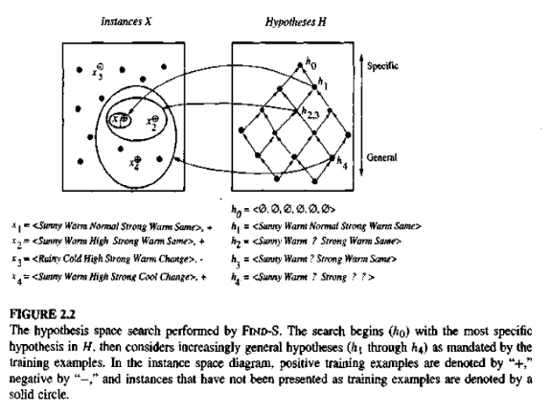
‹#›

Slide 20
The key property of the FIND-S algorithm is that for hypothesis spaces described by conjunctions of attribute constraints (such as H for the EnjoySport task), FIND-S is guaranteed to output the most specific hypothesis within H
That is consistent with the positive training examples.
Its final hypothesis will also be consistent with the negative examples provided the correct target concept is contained in H, and provided the training examples are correct.
Issues: Has the learner converged to the correct target concept?
Why prefer the most specific hypothesis?
Are the training examples consistent?
What if there are several maximally specific consistent hypotheses?
‹#›

Slide 21
VERSION SPACES AND THE CANDIDATE-ELIMINATION ALGORITHM
This section describes a second approach to concept learning, the CANDIDATE ELIMINATION Algorithm, that addresses several of the limitations of FIND-S.
Notice that although FIND-S outputs a hypothesis from H, that is consistent with the training examples, this is just one of many hypotheses from H that might fit the training data equally well.
The key idea in the CANDIDATE-ELIMINATION Algorithm is to output a description of the set of all hypotheses consistent with the training examples.
‹#›

Slide 22
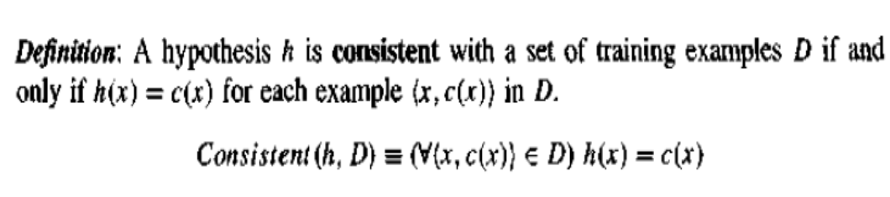
Surprisingly, the CANDIDATE-ELIMINATION Algorithm computes the description of this set without explicitly enumerating all of its members.
This is accomplished by again using the more-general-than partial ordering, this time to maintain a compact representation of the set of consistent hypotheses and to incrementally refine this representation as each new training example is encountered.
‹#›

Slide 23
Notice the key difference between this definition of consistent and our earlier definition of satisfies. An example x is said to satisfy hypothesis h when h(x) = 1, regardless of whether x is a positive or negative example of the target concept.
However, whether such an example is consistent with h depends on the target concept, and in particular, whether h(x) = c(x).
The CANDIDATE-ELIMINATION Algorithm represents the set of all hypotheses consistent with the observed training examples.
This subset of all hypotheses is called the version space with respect to the hypothesis space H and the training examples D, because it contains all plausible versions of the target concept.
‹#›

Slide 24
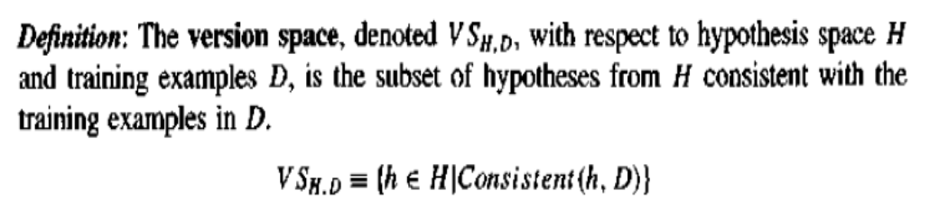
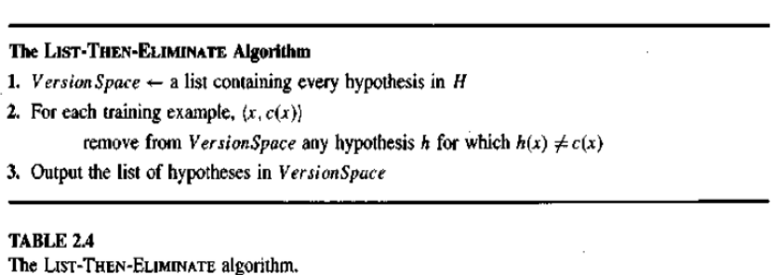
The LIST-THEN-ELIMINATE Algorithm
‹#›
Notes:
‹#›

Slide 25
A More Compact Representation for Version Spaces
However, it employs a much more compact representation of the version space.
In particular, the version space is represented by its most general and least general members.
These members form general and specific boundary sets that delimit the version space within the partially ordered hypothesis space.
The CANDIDATE-ELIMINATION Algorithm represents the version space by storing only its most general members (labeled G in Figure 2.3) and its most specific (labeled S in the figure).
‹#›

Slide 26
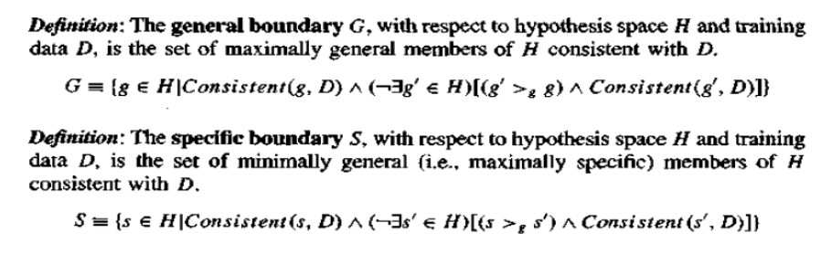
Given only these two sets S and G, it is possible to enumerate all members of the version space as needed by generating the hypotheses that lie between these two sets in the general-to-specific partial ordering over hypotheses.
It is intuitively plausible that we can represent the version space in terms of its most specific and most general members.
Below we define the boundary sets G and S precisely and prove that these sets do in fact represent the version space.
‹#›

Slide 27
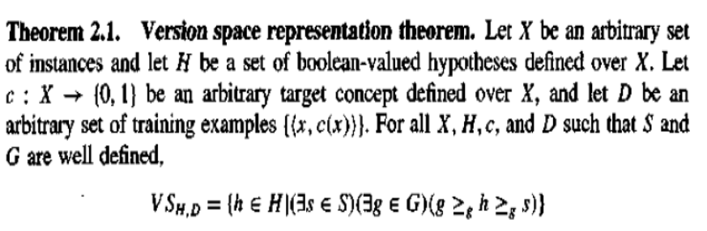
As long as the sets G and S are well defined (see Exercise 2.7), they completely specify the version space.
In particular, we can show that the version space is precisely the set of hypotheses contained in G, plus those contained in S, plus those that lie between G and S in the partially ordered hypothesis space.
This is stated precisely in Theorem 2.1.
‹#›

Slide 28
CANDIDATE-ELIMINATION Algorithm
The CANDIDATE-ELIMINATION Algorithm computes the version space containing all hypotheses from H that are consistent with an observed sequence of training examples.
It begins by initializing the version space to the set of all hypotheses in H; that is, by initializing the G boundary set to contain the most general hypothesis in H
{(?, ?, ?, ?, ?, ?)}
and initializing the S boundary set to contain the most specific (least general) hypothesis
(θ, θ , θ, θ, θ, θ)
‹#›

Slide 29
These two boundary sets delimit the entire hypothesis space, because every other hypothesis in H is both more general than So and more specific than Go.
As each training example is considered, the S and G boundary sets are generalized and specialized, respectively, to eliminate from the version space any hypotheses found inconsistent with the new training example.
After all examples have been processed, the computed version space contains all the hypotheses consistent with these examples and only these hypotheses.
‹#›

Slide 30
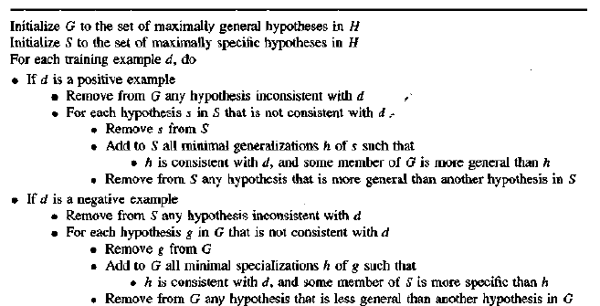
‹#›

Slide 31
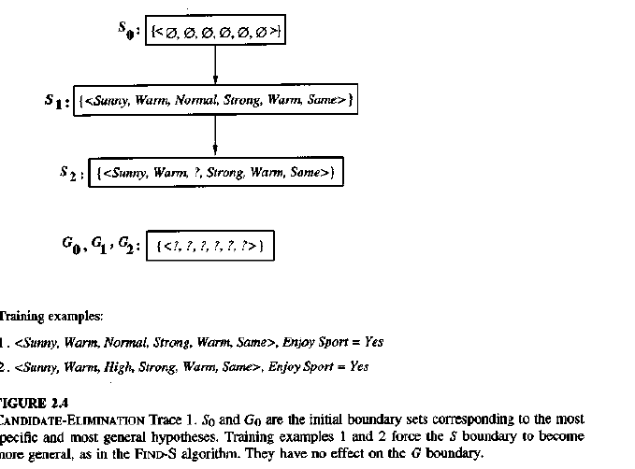
‹#›

Slide 32
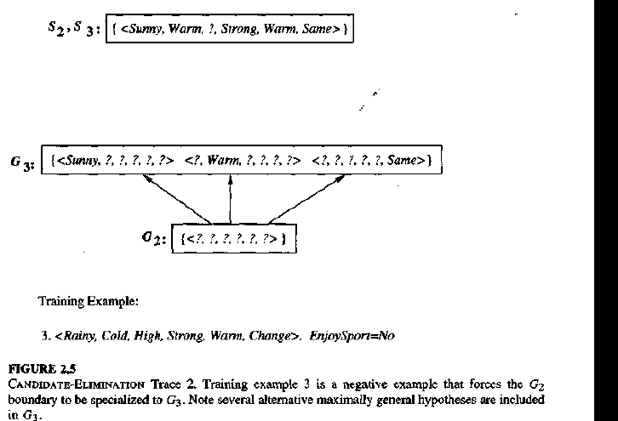
‹#›

Slide 33
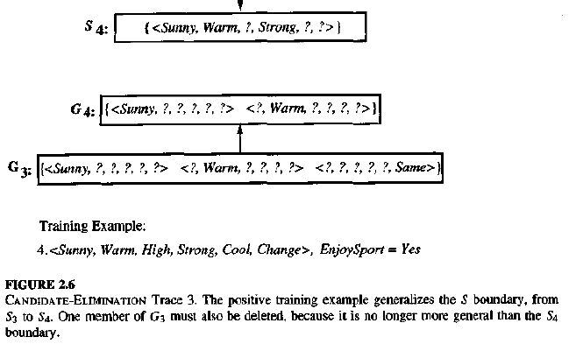
‹#›

Slide 34
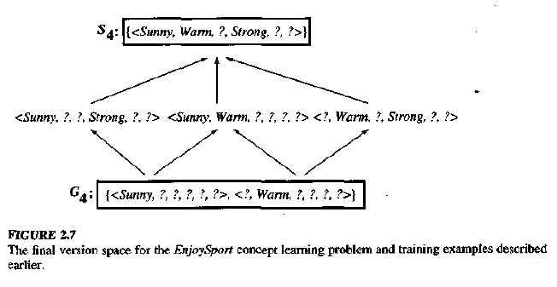
‹#›

Slide 35
REMARKS ON VERSION SPACES AND CANDIDATE-ELIMINATION
Will the CANDIDATE ELIMINATION Algorithm Converge to the Correct Hypothesis?
The version space learned by the CANDIDATE ELIMINATION will converge toward the hypothesis that correctly describes the target concept, provided (1) there are no errors in the training examples, and (2) here is some hypothesis in H that correctly describes the target concept.
In fact, as new training examples are observed, the version space can be monitored to determine the remaining ambiguity regarding the true target concept
‹#›

Slide 36
and to determine when sufficient training examples have been observed to unambiguously identify the target concept.
The target concept is exactly learned when the S and G boundary sets converge to a single, identical, hypothesis.
What Training Example Should the Learner Request Next?
The size of the version space is reduced by half with each new example, and the correct target concept can therefore be found with only O(log2(VS)) experiments
in general it may not be possible to construct an instance that matches precisely half the hypotheses.
In such cases, a larger number of queries may be required than O(log2(VS))
How Can Partially Learned Concepts Be Used?
‹#›

Slide 37



